Slide 1
Who Let the Dogs (and Cats) Out and How Did They Get There to Begin With? Toward an Understanding of Pet Intake and Adoption at the Austin Animal Shelter
Matthew Hoff, Simon Tidd, Jugal Kapadia, & Ellen Guerrero

Slide 2
Motivation and Summary Slide
Research Interest:
What brings animals into Austin’s Animal Shelter and
how long to they stay?
Data and Analysis:
City of Austin Data Portal - Animal Center Intakes and Outcomes
Q1: Impact of Holidays on Intakes
Q2: Identity and Bonding
Q3: Adoptions Gone Wrong
Notes:
Began with an exploration of data about Austin using the CIty of Austin’s data portal - we had a shared interest in animals and decided to look deeper into the data available from Austin’s Animal Shelter
Data was focused on documenting intakes and outcomes so we decided to formulate research questions center on factors affecting intake and adoption

Slide 3
Data Cleanup & Exploration
Data Structure
Intake and Outcome Files
Animal by Event / Unique Animal ID
Date and Time Stamped
Data Cleanup and Exploration
Managing Time
Understanding Outcomes
Frequency of Variable Values
Notes:
Datasets start in 2013 and continue through the present
Diversity of animals but vast majority are dogs and cats
Each intake and outcome is a row and has a date/time stamp
92% of animals have one intake; another 6% have a second intake with a small number with 3+
Animals species, breed, age, intake circumstances - condition / reason, and sex are captured
Shelter is no-kill so vast majority of animals are adopted or transferred to another partner
Matched records based on animal ID and temporal order
Constrained in part by low frequency in some key variables - ex., a few high frequency dog breeds

Slide 4
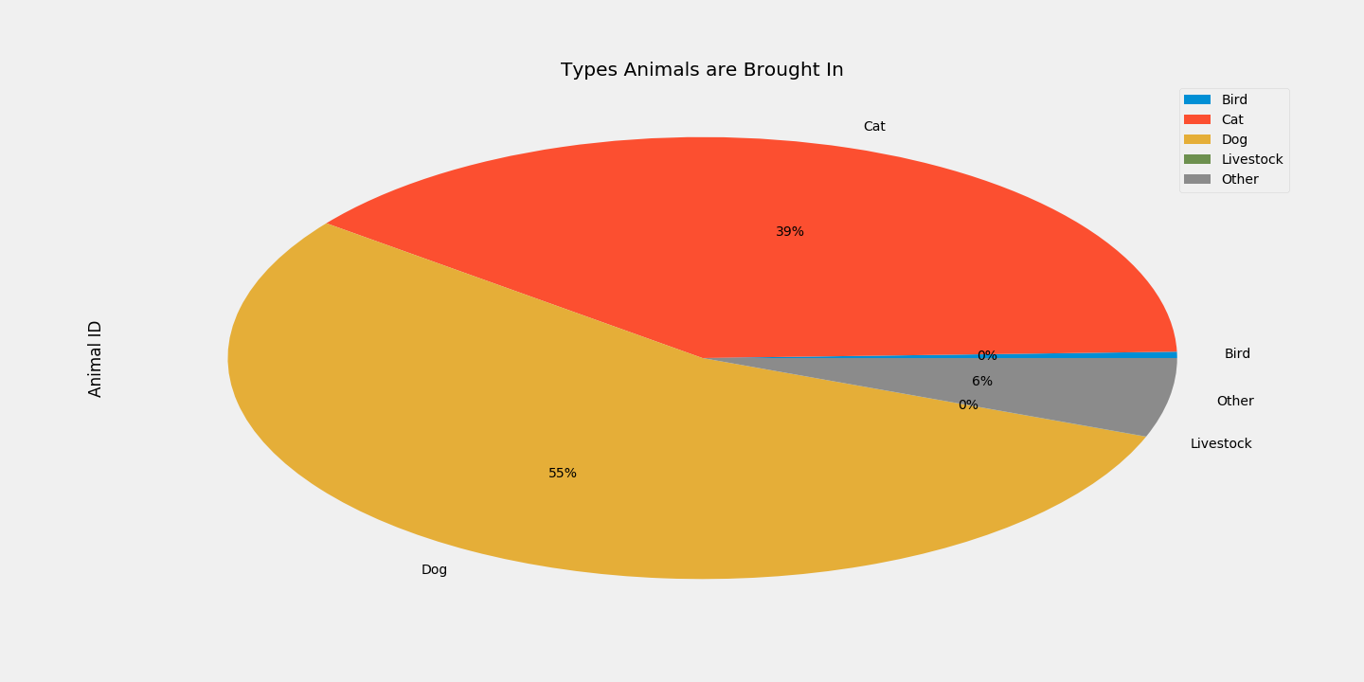
Demographics Breakdown of Shelter Intake
Notes:
Questions & Data
Elaborate on the questions you asked, describing what kinds of data you needed to answer them, and where you found it
Wanted to check the demographic animals were being brought into the shelter and compare it through a distribution.
Data Analysis
Discuss the steps you took to analyze the data and answer each question you asked in your proposal
Needed to filter down our data set to include just “normal” intake reasons again
Compare adopted to return count to get a rate of return.
Created new dataframes that contained just the data that I wanted filtered down to (touch on filtering columns by contains text/excludes text).
Did some basic math to calculate the rate of return.
Present and discuss interesting figures developed during analysis, ideally with the help of Jupyter Notebook
Discuss the visualization (brief overview of the visualization).
Discussion
Discuss your findings. Did you find what you expected to find? If not, why not? What inferences or general conclusions can you draw from your analysis?
I found that pit bull breeds had a higher rate of return but not as drastic of a difference as I expected.
We can conclude that pit bulls are returned at a higher rate than non-pit bull breeds but only by a difference of less than three percent.

Slide 5
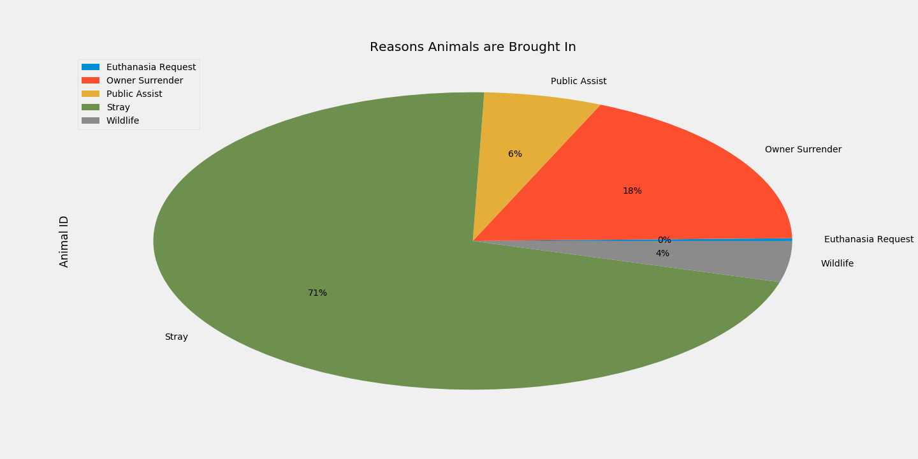
Reasons for Animal Intake Distribution
Notes:
Questions & Data
Elaborate on the questions you asked, describing what kinds of data you needed to answer them, and where you found it
Wanted to check the reasons animals were being brought into the shelter and compare it through a distribution.
Data Analysis
Discuss the steps you took to analyze the data and answer each question you asked in your proposal
Needed to filter down our data set to include just “normal” intake reasons again
Compare adopted to return count to get a rate of return.
Created new dataframes that contained just the data that I wanted filtered down to (touch on filtering columns by contains text/excludes text).
Did some basic math to calculate the rate of return.
Present and discuss interesting figures developed during analysis, ideally with the help of Jupyter Notebook
Discuss the visualization (brief overview of the visualization).
Discussion
Discuss your findings. Did you find what you expected to find? If not, why not? What inferences or general conclusions can you draw from your analysis?
I found that pit bull breeds had a higher rate of return but not as drastic of a difference as I expected.
We can conclude that pit bulls are returned at a higher rate than non-pit bull breeds but only by a difference of less than three percent.

Slide 6
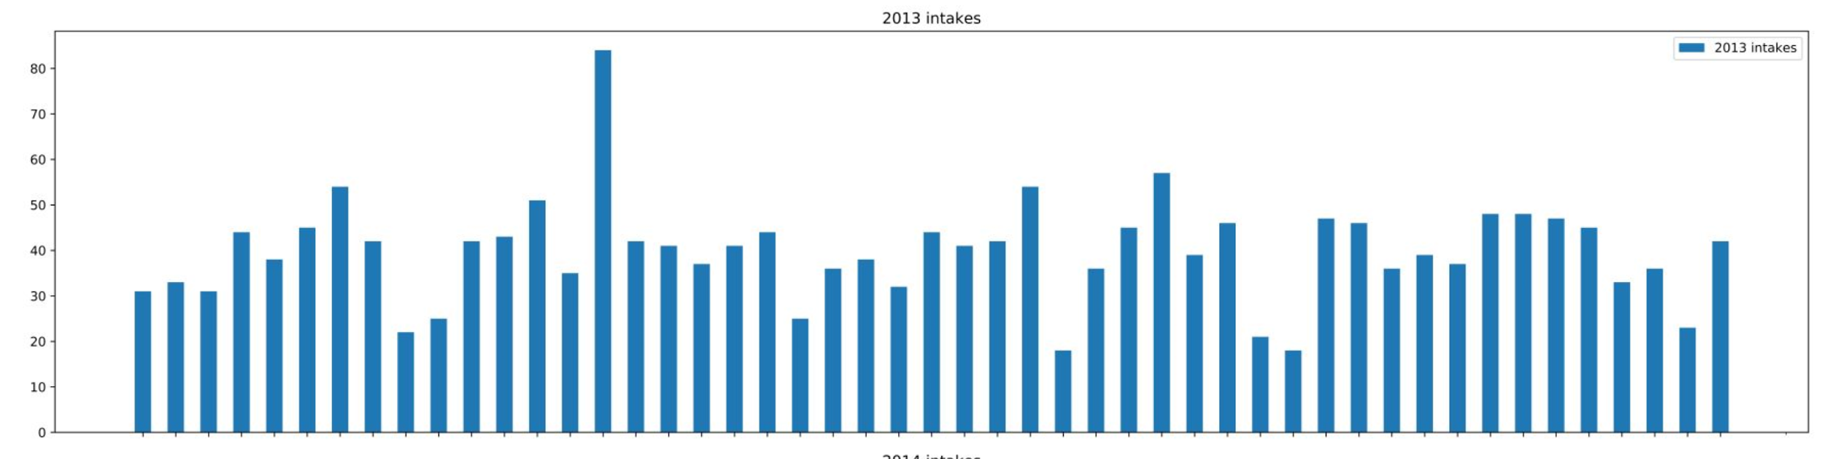
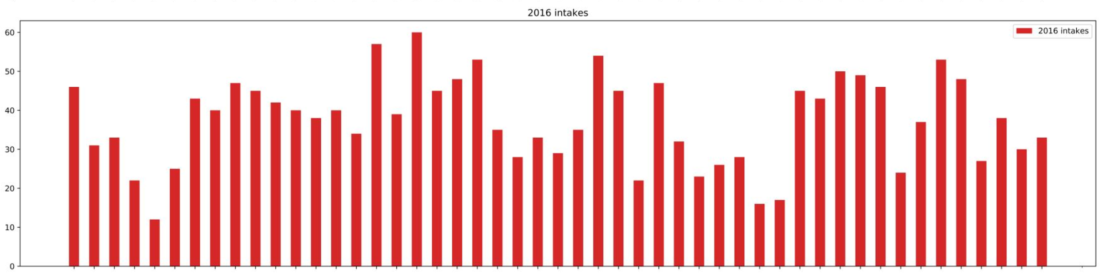
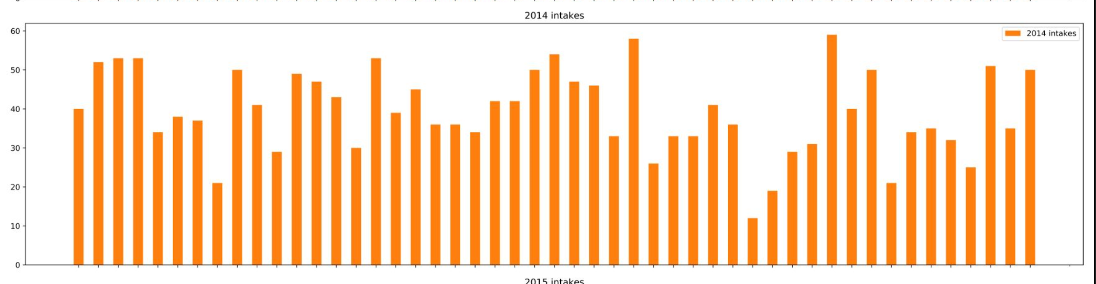
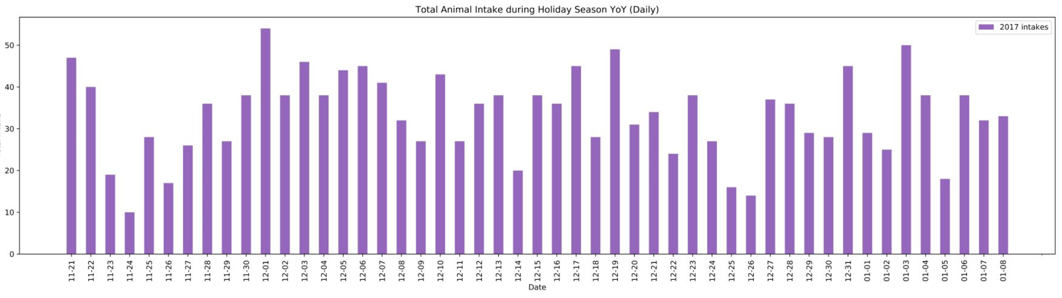
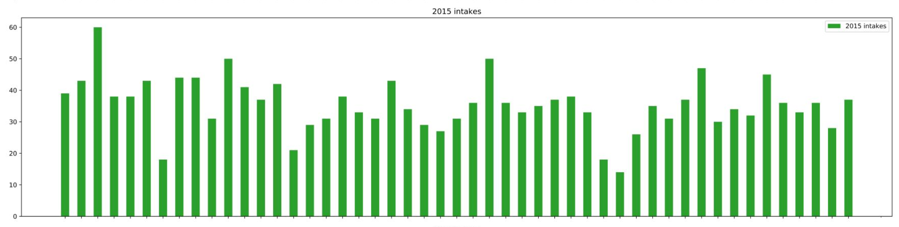
Are animals more likely to be surrendered/are shelter intake rates higher over the winter holiday season? (Thanksgiving/Christmas/New Years)
Notes:
Questions & Data
Elaborate on the questions you asked, describing what kinds of data you needed to answer them, and where you found it
The first question based on the data we had from Austin Animal center, was to determine if there is a higher intake rate of animals over the holiday season. Holiday season means travel and habitat change in most instances so the idea was to confirm if there is a trend in Austin related to the time of year and the intake rate.
Data Analysis
Discuss the steps you took to analyze the data and answer each question you asked in your proposal
First, I took the data and limited to Nov -Jan YoY- from that, the amount of intakes per day and layered the data to see if there were peak times each year, or around any holiday
Present and discuss interesting figures developed during analysis, ideally with the help of Jupyter Notebook
Interesting spike and YoY trend of getting lower intake
Discussion
Discuss your findings. Did you find what you expected to find? If not, why not? What inferences or general conclusions can you draw from your analysis?
I personally had expected to find that there was higher intake around the holidays, but it appears to be the times between with higher rates. After further thought, typically establishments are closed or have limited hours on the holidays themselves so this shows in the drop on the day of Christmas for example. There was also a big jump 12/5/2013, so it would be interesting to dive into the goings-on in the city of Austin during that time. Over time- it also appears the overall intake rates are decreasing YoY. A general conclusion is that holidays themselves are low intake but there is not a dramatic increase within the holiday season. The next step would be comparing during off season (summer/Spring)

Slide 7
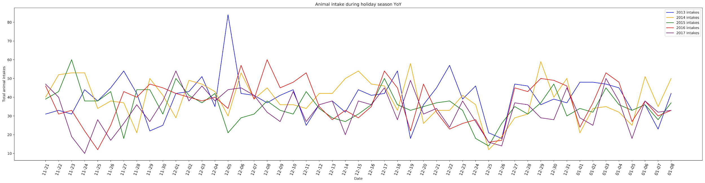
Are animals more likely to be surrendered/are shelter intake rates higher over the winter holiday season? (Thanksgiving/Christmas/New Years)
Notes:
Questions & Data
Elaborate on the questions you asked, describing what kinds of data you needed to answer them, and where you found it
The first question based on the data we had from Austin Animal center, was to determine if there is a higher intake rate of animals over the holiday season. Holiday season means travel and habitat change in most instances so the idea was to confirm if there is a trend in Austin related to the time of year and the intake rate.
Data Analysis
Discuss the steps you took to analyze the data and answer each question you asked in your proposal
First, I took the data and limited to Nov -Jan YoY- from that, the amount of intakes per day and layered the data to see if there were peak times each year, or around any holiday
Present and discuss interesting figures developed during analysis, ideally with the help of Jupyter Notebook
Interesting spike and YoY trend of getting lower intake
Discussion
Discuss your findings. Did you find what you expected to find? If not, why not? What inferences or general conclusions can you draw from your analysis?
I personally had expected to find that there was higher intake around the holidays, but it appears to be the times between with higher rates. After further thought, typically establishments are closed or have limited hours on the holidays themselves so this shows in the drop on the day of Christmas for example. There was also a big jump 12/5/2013, so it would be interesting to dive into the goings-on in the city of Austin during that time. Over time- it also appears the overall intake rates are decreasing YoY. A general conclusion is that holidays themselves are low intake but there is not a dramatic increase within the holiday season. In general, on holiday date, intake is lower. The next step would be comparing during off season (summer/Spring)

Slide 8
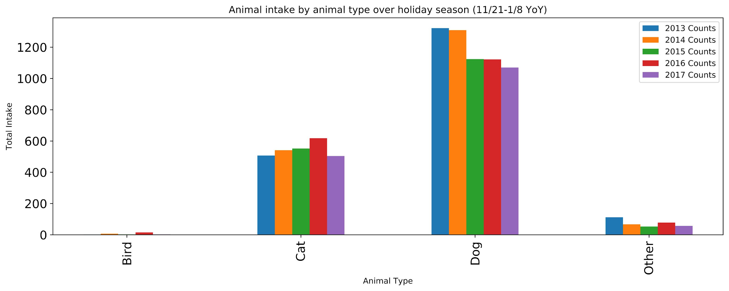
Do specific animal types have a higher intake rate over the holiday season?
Notes:
Questions & Data
Elaborate on the questions you asked, describing what kinds of data you needed to answer them, and where you found it
In the vein of intake around the holidays, we also wanted to determine if specific animal types have a higher intake rate, collectively. For example, are dogs likely to have a higher intake that may correlate with the difficulty around traveling with them?
Data Analysis
Discuss the steps you took to analyze the data and answer each question you asked in your proposal
I took the same intake data but broke it down by animal type and summed it over the holiday period used. With further analysis, it would be ideal to compare ratio of animal type intake. Was the intake of dogs higher because it was higher, or is this relative to the overall total intake of dogs on average.
Present and discuss interesting figures developed during analysis, ideally with the help of Jupyter Notebook
Dogs have the highest intake rate, but that appears to be decreasing YoY. Cats appear to be increasing, until 2017, when all intakes dropped.
Discussion
Discuss your findings. Did you find what you expected to find? If not, why not? What inferences or general conclusions can you draw from your analysis?
I did expect to find dogs as the highest overall due to their population, but I also would like to dig into what types of intakes drive these numbers, are they mostly strays or owner surrender? - General conclusion, dogs are more popular so they have a higher intake rate. Additionally, overall intake rates are getting lower over time, possibly due to the city’s increased population and accessibility to affordable care/new initiatives for care

Slide 9
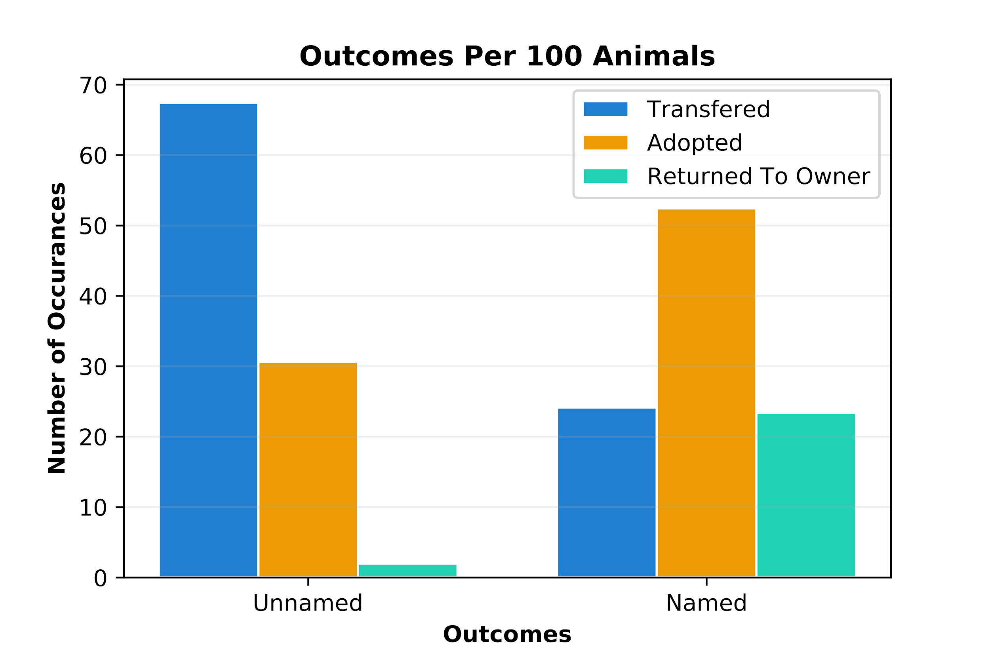
Are Named Animals Adopted at a
Higher Rate Than Unnamed?
Notes:
Questions & Data
Elaborate on the questions you asked, describing what kinds of data you needed to answer them, and where you found it
Wanted to know if being assigned a name in the shelter affected an animal’s adoption rate.
Data Analysis
Discuss the steps you took to analyze the data and answer each question you asked in your proposal
Needed to filter down our data set to include just “normal” intake reasons and look at the count of both named and unnamed animals to compare.
Identified which columns would need to be kept
Created new dataframes that contained just the data that I wanted filtered down to.
Did some basic math to calculate the rate of possible outcomes.
Present and discuss interesting figures developed during analysis, ideally with the help of Jupyter Notebook
Discuss the visualization (brief overview of the visualization).
Discussion
Discuss your findings. Did you find what you expected to find? If not, why not? What inferences or general conclusions can you draw from your analysis?
I found that named animals were adopted at a higher rate than unnamed animals.
That many of the unnamed animals were transferred to other facilities
That very few unnamed animals were returned to their owners
I expected to find this to be the case.
We can conclude that animals with names are adopted at a higher rate than unnamed.

Slide 10
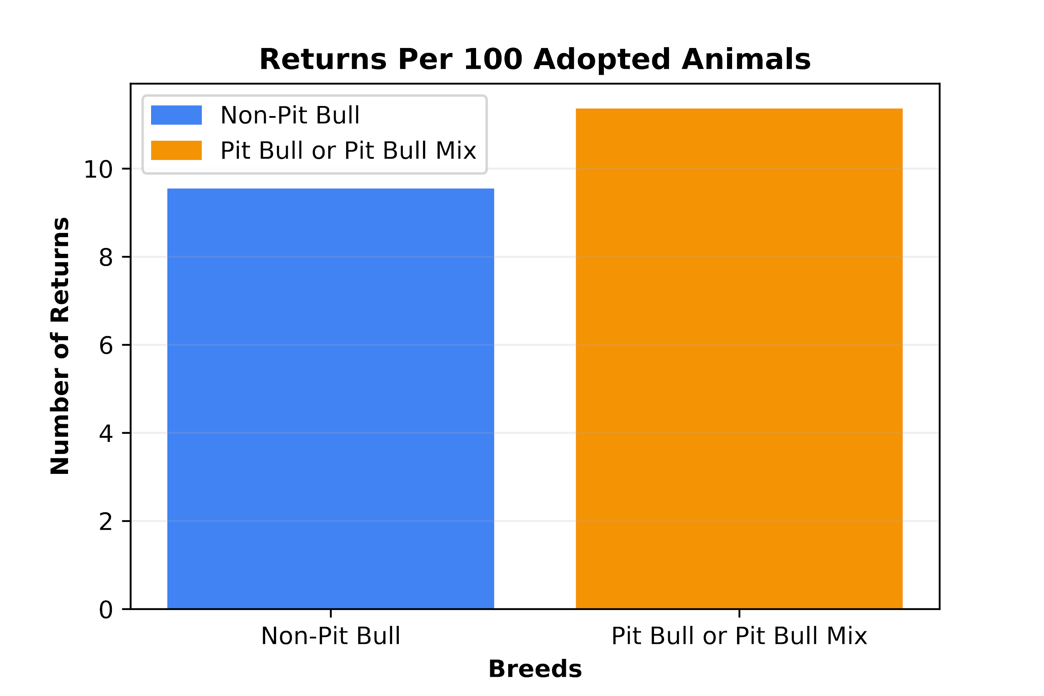
Do Pit Bull or Non-Pit Bull Breeds
Have a Higher Return Rate?
Notes:
Questions & Data
Elaborate on the questions you asked, describing what kinds of data you needed to answer them, and where you found it
Wanted to know if breed had any correlation with the return of animals to the shelter. Specifically wanted to look at the difference between Pit Bull/Pit Bull mix and non-pit bull breeds
Data Analysis
Discuss the steps you took to analyze the data and answer each question you asked in your proposal
Needed to filter down our data set to include just “normal” intake reasons again
Compare adopted to return count to get a rate of return.
Created new dataframes that contained just the data that I wanted filtered down to (touch on filtering columns by contains text/excludes text).
Did some basic math to calculate the rate of return.
Present and discuss interesting figures developed during analysis, ideally with the help of Jupyter Notebook
Discuss the visualization (brief overview of the visualization).
Discussion
Discuss your findings. Did you find what you expected to find? If not, why not? What inferences or general conclusions can you draw from your analysis?
I found that pit bull breeds had a higher rate of return but not as drastic of a difference as I expected.
We can conclude that pit bulls are returned at a higher rate than non-pit bull breeds but only by a difference of less than three percent.

Slide 11
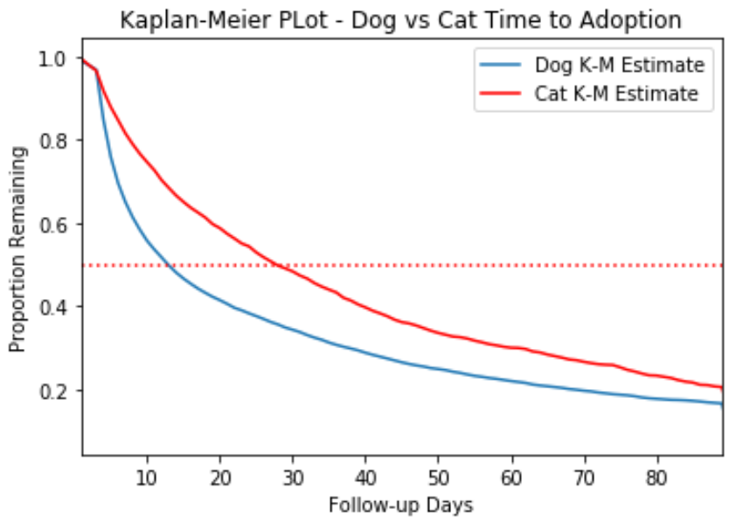
Toward a Deeper Understanding of
Time to Adoption
Notes:
Ellen’s analysis looked at variability at key points in the year - around holidays - related to level of intake
Potential to explore in more detail the timing of adoption
Survival analysis models time to event data - can build complex regression models predicting likelihood of event (i.e., adoption)
Preliminary step is to explote Kaplan-Meier plot - estimates an underlying survival function describing the proportion remaining at any given time
Makes best use of available data including cases that leave the sample for other reasons
Often look at the time it takes to reach 50% remaining - difference between the dog and cat curves shows that it takes approximately 16 more days for the cat population to reach 50% than the dog population

Slide 12
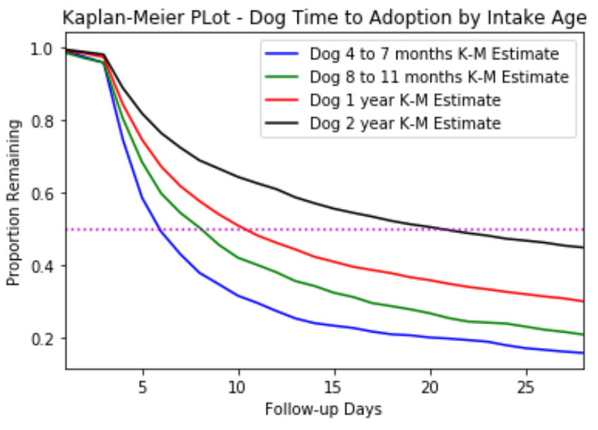
Puppy Love?
Notes:
Can push the analysis further by splitting the data categorically
Here broke down dogs by age
Proved definitively that people like puppies!

Slide 13
Post Mortem
Headaches and Aspirin
“Muddy” start to the dataset
Aligning dates for Thanksgiving
Comparable breeds
Scarce follow-up data for some animal ages
Have dataset, will travel...
Statistical comparisons - pre-holiday-post; names/no-names; breed and return
Multivariate modeling of time to exit
Cluster analysis of animal characteristics/circumstances and outcomes

Slide 14

Questions?

